Slide 1
Small cell lung cancer
Hanan .A.Eltyb
2015

Slide 2
Incidence
Approximately 15% of bronchogenic carcinomas.
In the year 2013, an estimated 31.000 new cases will be diagnosed at USA.
Nearly all cases are attributed to cigarette smoking.
Smoking cessation: reduce
risk of death in localized SCLC by 50% according to ESMO guidelines

Slide 3
Natural history & prognosis:
Small-cell lung cancer (SCLC) originates from neuroendocrine-cell precursors.
Rapid doubling time, high growth fraction.
Early development of widespread metastases.
High response rates to both chemotherapy and radiotherapy.
SCLC is the most common solid tumor associated with paraneoplastic syndromes: SIADH, ACTH production syndrome, peripheral neuropathy and Eaton-Lambert syndrome.

Slide 4
Usually relapses within two years despite treatment (2ys DFS~10%), and most of patients die from recurrent disease.
Development of treatment resistance in patients with metastatic disease.
Without treatment: median survival from diagnosis is 2 - 4 months.
~ 30 % presented by limited disease.
10-15% of patients present with brain metastases and 2 year incidence after chemo-RT is 50–80%.
Median survival after recurrence ~ 4 ms.

Slide 5
Clinical presentation
Typically arise centrally.
Most common presentation is a large hilar mass with bulky mediastinal LNs.
Common symptoms cough, dyspnea, wt loss.
Approx. 70 % with overt mets at presentation.
Commonly spread to liver, adrenals, bone and brain.
Can present with paraneoplastic syndome.

Slide 6
Staging:
The former 1989 InternationalAssociation for the Study of Lung Cancer (IASLC) staging system :
Limited stage (LS):
Disease confined to one hemithorax and regional nodes (historically defined as fitting into a single radiation port)
Extensive stage (ES):
Any disease not meeting limited stage criteria

Slide 7
AJCC TNM staging system:
Limited stage:
Stage I-III,(T any-N any-M0 ).
Exclude:
T3-4 with multiple lung nodules.
T3-4 with tumor/nodal volume that does not fit in a tolerable radiation plan.
Extensive stage:
Stage IV ,(T any-N any-M1).
T3-4 with multiple lung nodules.
T3-4 with tumor/nodal volume that does not fit in a tolerable radiation plan.

Slide 8
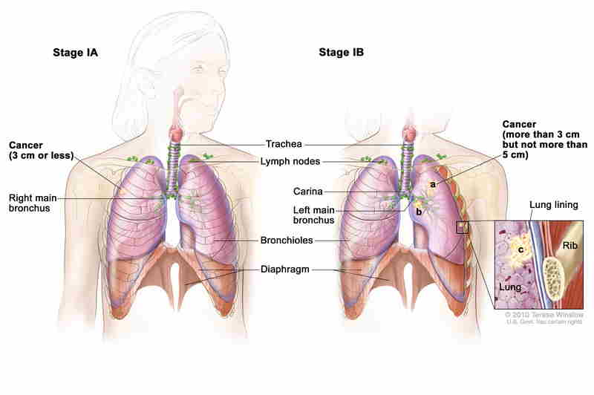

Slide 10
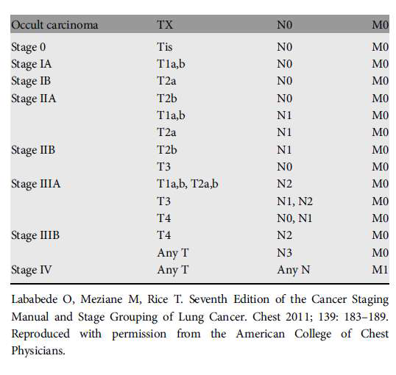

Slide 11
workup
Lab
Diff CBC
Electrolytes
LFT - RFT
LDH
PATHOLOGY
RADIOLOGY: -Chest/liver/adrenal CT
-Brain MRI
-PET/CT (limited stage-Pathological confirmation)

Slide 12
Additional Workup
Limited stage
Thoracocentesis
Thoracoscopy
PFT/CT
Bone image ( equivocal PET)
Bone marrow
Mediastinal staging (T1-2 ,N0)

Slide 13
Surgery in SCLC
Only 5% of cases.
For Stage I: (T1-2 , N0).
Biopsy to confirm –ve mediastinal LNs.
Type: lobectomy with mediastinal staging or sampling
Adjuvant CTx is recommended after complete excision, (If –ve LNs.), add RTx to chemo (If +ve LNs).
Followed by PCI
5 years OS= 40-60%.

Slide 14
Limited stage
Concurrent chemoradiation
VP16/CIS +RTx
Maximum 4-6 cycles
Myeloid growth factors is not recommended

Slide 15
Benefit of RTx:
CTx-RTx alone VS CTx.
was shown in a 2 meta-analyses: (Pinon et al, NEGM, 1992), (warde et al, JCO, 1992): 5 % improvement of 2-ys OS
Concurrent CTRTx
Is the standard and preferred to seguential with survival improvement
Should start early with cycle 1 or 2 with chemotherapy

Slide 16
Extensive stage
Combination chemotherapy
palliative RTx : -SVC syndrom
-Lobar obstruction
-spinal compression
-bone mets
-Brain mets (may delayed after chemotherapy if asymptomatic)
Sequential RT to thorax in selected pts with Low bulk metastatic disease with CR or near CR after CTx(ongoing CREST trial).

Slide 17
Cis-Vepsid vs CAV
Head to head trial failed to show survival advantage.
But, it seems that Cis-VP16 is better tolerated and has good responses.
Equal efficacy of cisplatin and carboplatin in SCLC
NCCN recommend Cis-VP16 maximum 4-6 cycles
as the standard of care.

Slide 18
Irinotecan : As First Line Option
Irino-cis VS Cis-VP16:
Survival benefit in a Japanese phase III trial:
13 ms vs 9.5 ms (NEGM, 2002).
Failed to show survival benefit in 2 phase III American trials.
PFS improved in a meta-analysis, J Thoracic Oncology, 2010 (not used individual pts data).
More GI toxicity.

Slide 19
Prophylactic Cranial Irradiation(PCI)
25 % decrease in 3-ys incidence of brain mets.
Improve both DFS and OS
Benefit was similar in both limited and extensive stage.
Indications:
Limited or extensive stage : CR or PR (any response)
Not in patient with poor performance or impaired neurocognitive function.

Slide 20
NO MAINTAINANCE
Role of maintenance therapy:
• Phase III trial, JCO, 2001.
• Adding Topotecan after 4-6 cycles of Cis-VP16.
• No survival benefit.
• Minor prolongation of the duration of response.
• Increase of cumulative toxicity.

Slide 21
Progressive Disease
Clinical Trial
Relapse > 6m: original CTx regimen
single agent CTx : Taxens-Irinotecan-Tobetecan-Gemcitabine-Temozolide-Vinorelbine-oral Vep16 – CAV
Till
2 cycles beyond best response
Toxicity
Progression
Consider dose reductions VS GSFs in the poor performance status patients.
RT to symptomatic sites

Slide 22
Topotecan as second line
Topotecan VS CAV:
Phase III trial, JCO, 1999.
Same survival.
Less toxicity with Topotecan.
Topotecan Oral. VS BSC:
Phase III trial, JCO, 2006.
Improved OS (26 ws VS 14 ws).
NCCN guidelines
Category 1: relapse > 3 ms.
Category 2A: relapse < 3 ms.
Similar toxicity of Oral and IV forms

Slide 23
SCLC in elderly patients:
• Under-presented in clinical trials.
• Similar prognosis as stage-matched younger pts.
• Attention to support body systems.
• VP16 as single agent is inferior to combination CTx.
• Prefered: 4 X Carbo AUC 5-VP16
Favourable results.
Takes into account declining renal function with aging.

Slide 24
Thanks

